Slide 1
Positive Behaviour Supports
Being Proactive

Slide 2
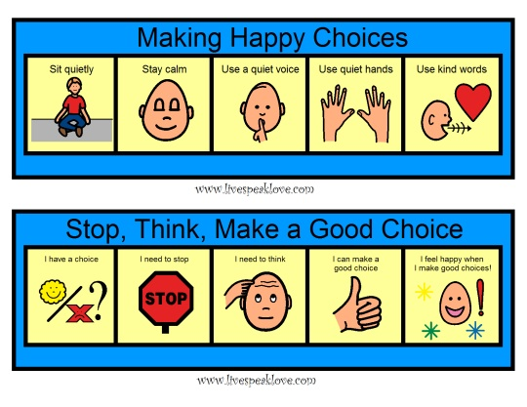
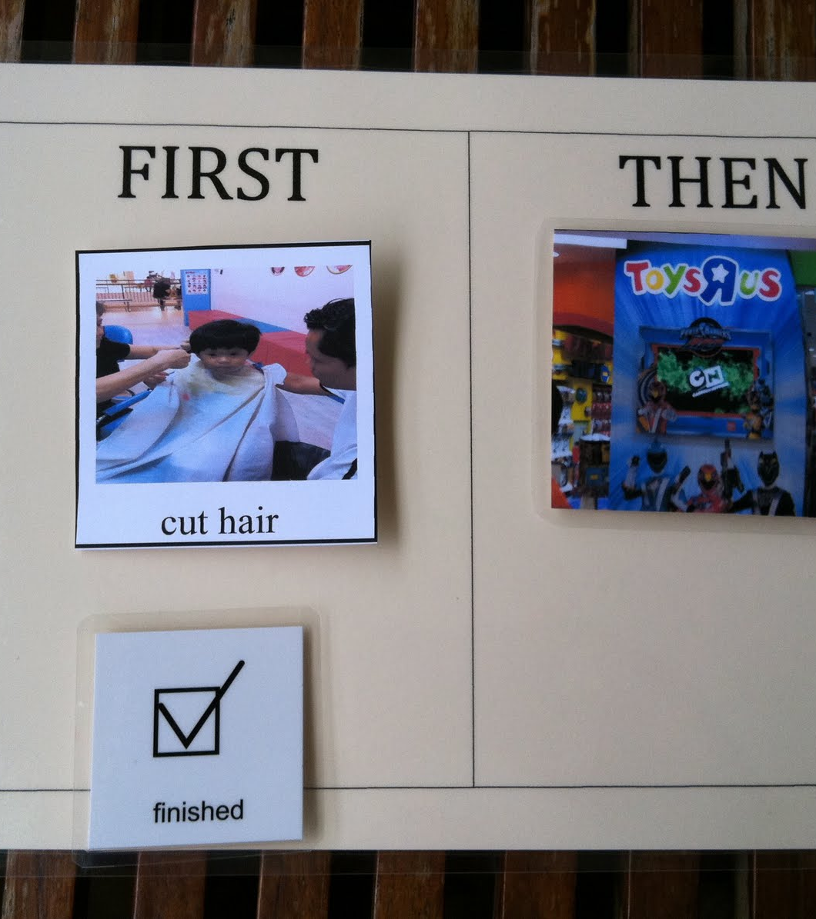
Environmental Factors

Slide 3
A-B-C
James is a seventh-grade student with difficulties in oral reading. In social studies class, each student is expected to take a turn reading part of the chapter out loud. When it is James’s turn, he responds by throwing his books on the floor and swearing at the teacher. His teacher responds by sending him to the vice-principal’s office. This behaviour continues and worsens over the Fall.

Slide 4
A-B-C
Michael, a second-grade student, pushes the other children in line when he is told to stand at the end of the line. When the teacher lets him hold the door, he stops pushing. This happens every time the students line up for lunch. This behaviour continues on a daily basis.

Slide 5
A-B-C
Madison is assigned to a work station with three or four other students. She hoards the materials and gets into spats. The teacher sends her away from the area to work by herself.

Slide 6

Examples of Hypothesis Statements
Sally makes loud noises when she is given a difficult assignment. She does this to get out of social studies.
When Ali does not sleep well, and is left alone, she hits herself. She does this to get attention.

Slide 7
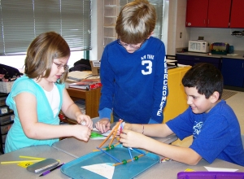
Predictability
Gives a structure and order to a day or activity that for a student feels unclear or unknown
Makes it easier for student (and you) to move through activities and day successfully

Slide 8
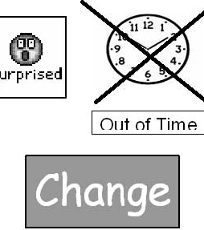
Predictability
Important to understand and know what is coming, particularly if its not expected or its something that can make a student feel anxious or excited
Planning and preparing for change helps

Slide 9
Levels of Prompts
Most to least
Natural cue
Gestures/modeling
Visuals
Verbal
Physical

Slide 10
Prompting
Prompts are used to increase the likelihood that a student will engage in the correct behaviour at the correct time and place
Given before or during a task
Introduced during the time when a student is learning or acquiring - discontinue after student has acquired skill or routine

Slide 11
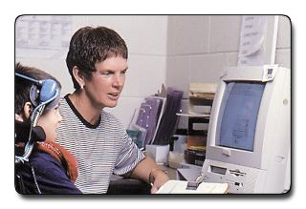
Prompt dependency
An overreliance or dependence on adult support, thus inhibiting independence
A particular concern with students who receive significant amounts of one-to-one support

Slide 12
Prompt dependency
May learn:
To only respond with prompts
‘Like the prompts’(attention)
‘Might as well wait’ for the right answer
Avoid by:
Keeping verbal prompts to a minimum - they are the most routine and the hardest to fade!
Observing and carefully planning the use and fading of any prompts

Slide 13
Prompting
The purpose is to assist the student to:
Attend to teacher instruction independently
Attend to other students when they respond independently
Complete seatwork accurately and independently
Follow classroom routines independently

Slide 14
Prompting
Prompts should ensure that the student can be successful with the activity
3 Keys
Add as little as possible to help the learner succeed
Fade the prompts as soon as possible
Certain types of prompts are much easier to fade than others

Slide 15
The Big Picture
Ecological Factors
Environmental
Social
Physical
Setting Events
Trigger
Obtain
Avoid

Slide 16
Intervention Plan
Prevent (A) Environment Curricular and instruction design Visual supports Setting events Choice and independence Interactive style | Replace (B) Self-monitoring Social skills Coping & problem solving strategies Prompting Communication skills or systems | Respond (C) Specific to the student Ignoring Redirecting Contingencies by educators and peers Crisis intervention

Slide 17
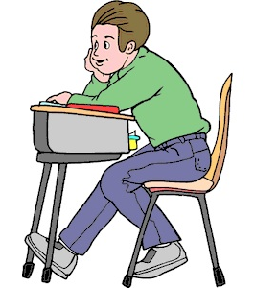
Replacement Behaviours
Rewrite: The student needs to settle down.
To: The student will stay in his seat when the teacher is instructing the class.

Slide 18
General Positive Behaviours
Organizational Skills | Solving Conflicts
writing down homework in agenda organizing desk organizing binders developing a timeline to finish a project on time to-do-lists; checklists | role-play class meetings social skills curriculums response to literature board games

Slide 19
General Positive Behaviours
Coping Strategies | Peer relationships
visuals social stories relaxation strategies time away or quiet area in classroom | pro social skill curriculums games; play groups mentor (peer or adults) role plays extra curricular activities

Slide 20
Teaching new behaviours
Teach in a systematic way (prompting levels, reinforce)
Logically related to the assessment
Function of the behaviour
What should the student do instead of the target behaviour
How is the environment supporting the behaviour
Teach general positive behaviours
Teach specific skills that allow the student to escape or obtain something in a more acceptable manner

Slide 21
Examples of Replacement Behaviours
Protest | Instead of swearing use simple acceptable (to teacher and student) protest language
Escape | Use a break card Go to a designated time away area Ask for help
Avoid | I want to work on...card I want to work with...card

Slide 22
Examples of Replacement Behaviours
Getting attention from peers | Using names at appropriate time Tapping on shoulder Introducing a topic Talking about peer interests
Requesting access to a preferred activity | Hand picture of desired activity

